Slide 1
Agenda
Topic: Overview Microservice
Reason: Sharing and improving
Author: Tuyen.Nguyen
Audience: Everyone
Microservice, Advantage, Disadvantage, …

Slide 2
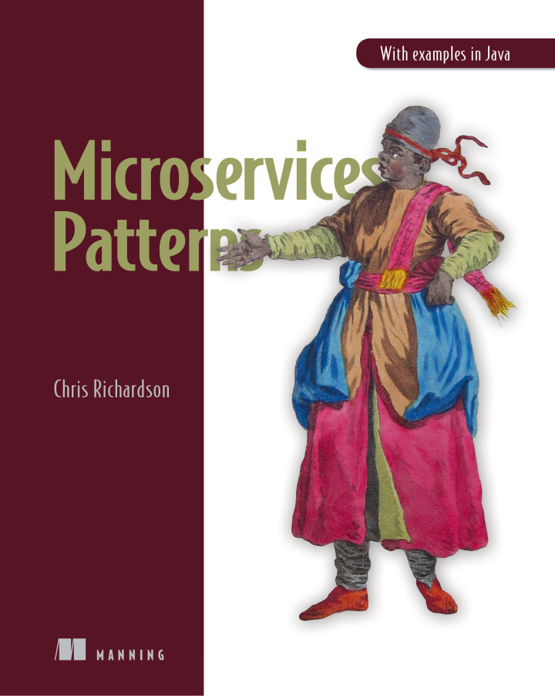
Documents
https://microservices.io/

Slide 3
Contents
Monolithic architecture
Monolithic Advantage and Disadvantage
Microservice architecture
Microservice Advantage and Disadvantage
Monolithic vs SOA vs Microservice architecture
Data consistency issues and Solution
Query join data issues and Solution
Example(Demo)

Slide 4
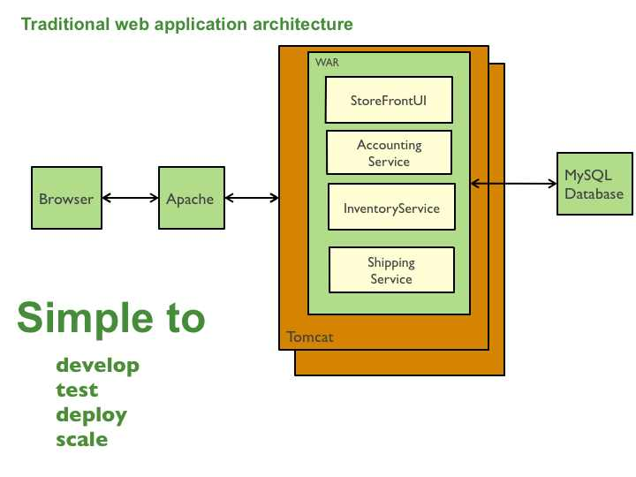
Monolithic architecture

Slide 5
Monolithic Advantage and Disadvantage
Advantage
Disadvantage
Simple to develop
Easy to make changes to the application.(Change code ==> database ==> Build ==> Deploy).
Deploy easy ==> just copy War file to server.
Easy to scale(Vertical: CPU, RAM, DISK, Network).
Applications too large for any developer to fully understand(fix bug and check affected).
Development is slow ==> component is coupling with other component
Deploy ==> Service is not active(Conflict with agile ==> delivery continuous).
Limited of Scale(Horizontal).
Difficult change to new technology | framework.

Slide 6
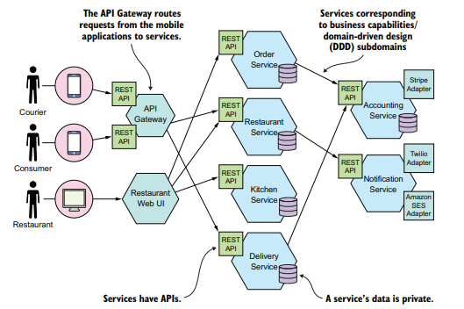
Microservice architecture
Notes:
==> It's architecture of application(system). Big application will be divided into smallest independent service units.
Microservice is multiple small service working together. Every service will executing one business need and it connected with each other.

Slide 7
Microservice Advantage and Disadvantage
Advantage
Disadvantage(Human)
Change request: adapt with Scrum(Agile).
Code: Independence language and technology
Develop faster
Services are independently deployed and Scalable
Services are small and easily Maintained.
Finding the right set of services is challenging
Distributed system ==> Senior engineer to manage(huge set of skilled professionals).
New architecture ➔ need developer learning to updated skills.
Error difficult to investigate

Slide 8
Microservice Disadvantage(Technical)
Issues
Solution
Network latency
Reduced availability due to synchronous communication(If other service is unavailable ==> service createOrder will can't be able to create.).
Maintaining data consistency across services.
Obtaining a consistent view of the data
Backup network
Asynchronous messaging(Message Queue).
Saga pattern
The CQRS(Command Query Responsibility Segregation)

Slide 9
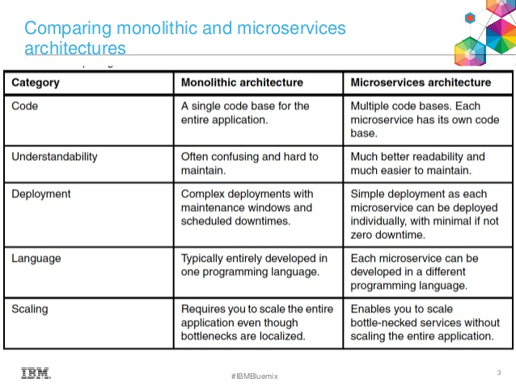
Notes:
-Estimate
-Change request: adapt with Scrum(Agile).
-Develop, Test, Deploy, Maintenance
-Scalable
-High available
-Update technology
-Release faster

Slide 10
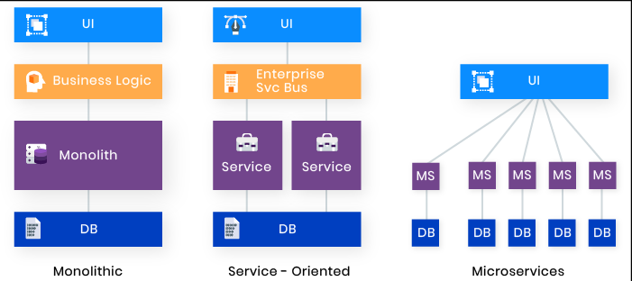
Monolithic vs SOA vs Microservice architecture
Notes:
The Service Oriented Architecture is an architectural design which includes collection of services in a network which communicate with each other.

Slide 11
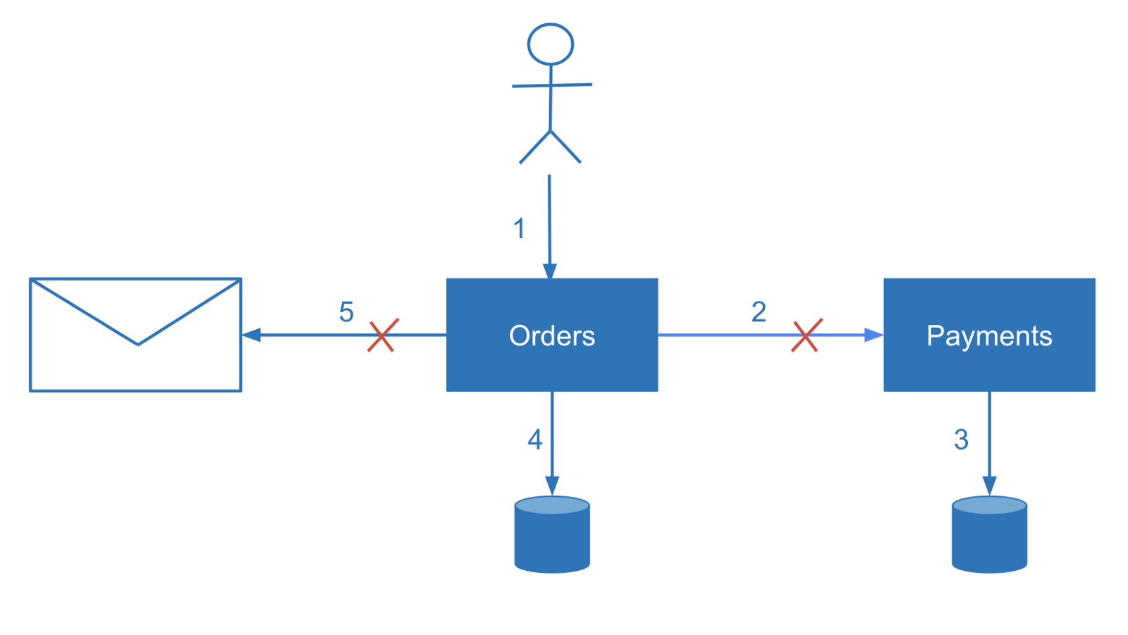
Data Consistency in Microservices Architecture
Notes:
https://dzone.com/articles/data-consistency-in-microservices-architecture

Slide 12
Solution
Two-phase commit (2PC) pattern
Single-Write With Events
Accepting Inconsistency
Pattern: Saga
sequence of local transactions(Message Broker)
Event-driven architectures
Notes:
https://microservices.io/patterns/data/saga.html

Slide 13
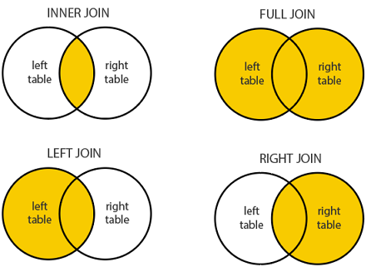
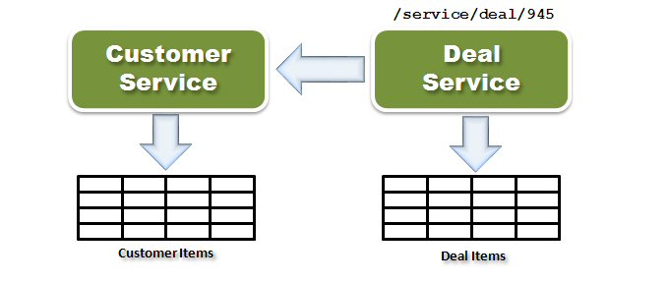
Query join data issues
Notes:
https://dzone.com/articles/data-consistency-in-microservices-architecture

Slide 14
Solution
API composition pattern
The CQRS(Command Query Responsibility Segregation)
Notes:
https://microservices.io/patterns/data/saga.html

Slide 15
IPC Inter-process communication
Synchronous
Asynchronous
Using REST
Using gRPC
gRPC is an open source remote procedure call (RPC)
Message broker
==> AMQP or STOMP

Slide 16
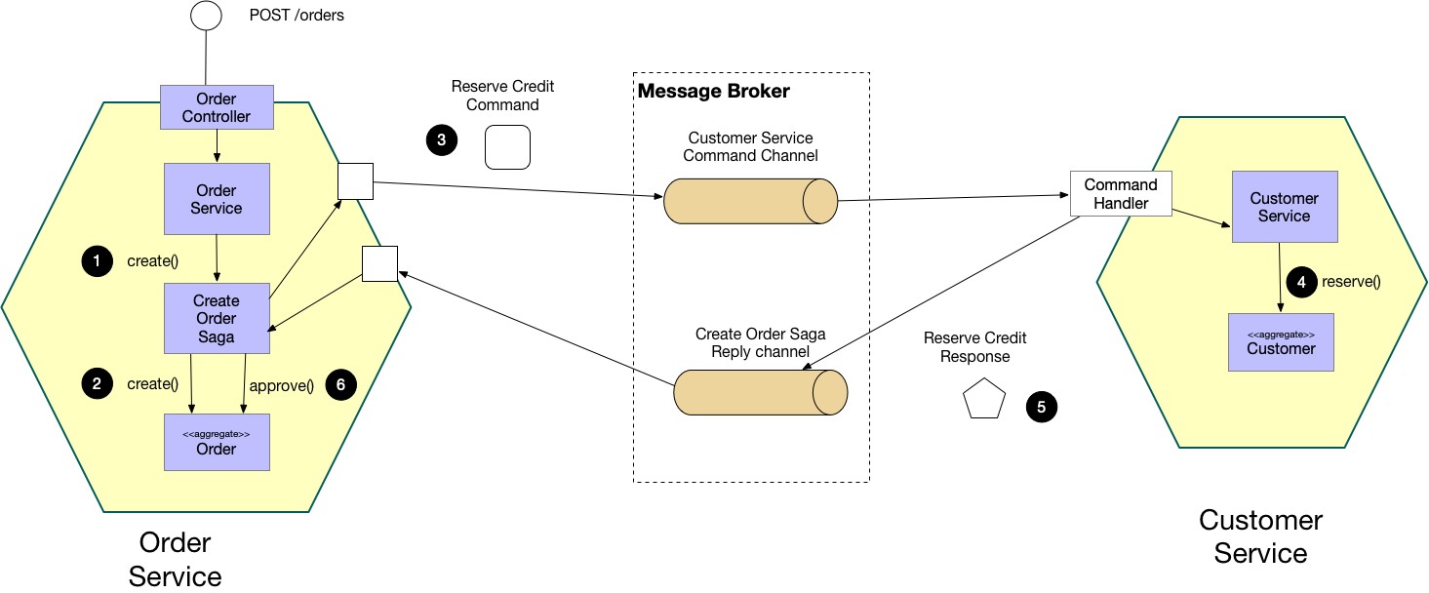
Saga pattern
LACK OF AGGREGATE HISTORY
IMPLEMENTING AUDIT LOGGING IS TEDIOUS AND ERROR PRONE

Slide 17
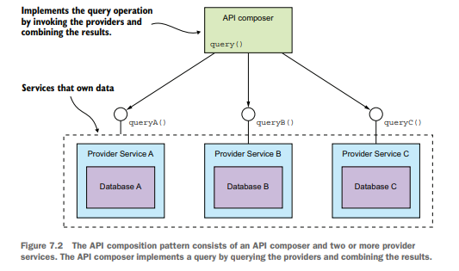
API composition pattern
The API composer implements the query by retrieving data from the provider services and combining the results.
Notes:
1. Increased overhead
2. Risk of reduced availability
3. Lack of transactional data consistency

Slide 18
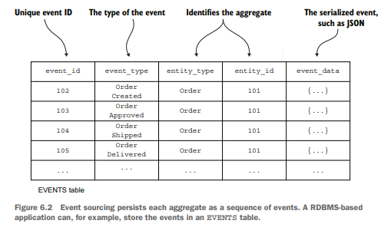
Event sourcing pattern

Slide 19
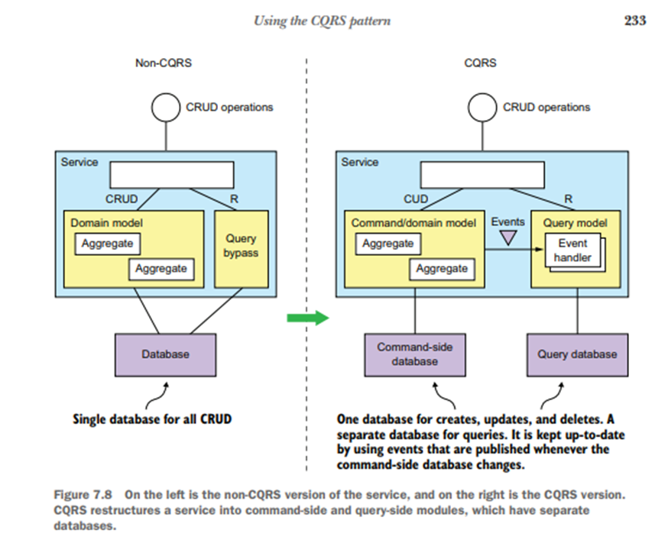
The CQRS Command Query Responsibility Segregation
Notes:
1. Application use an RDBMS as the transactional system of record.
2. Text search database, such as Elasticsearch or Solr for text search queries.
➔ Copy data from the RDBMS to the text search engine. ==> Strengths of the transactional properties of the RDBMS and the querying capabilities of the text database.

Slide 20
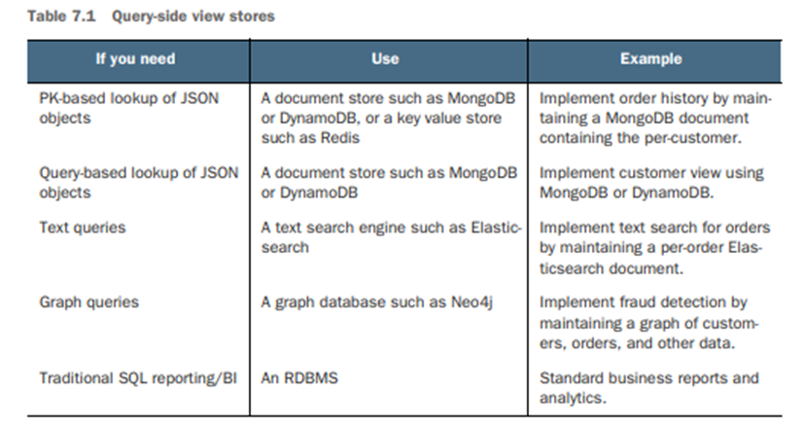
The CQRS Choosing a view datastore
Notes:
1. Application use an RDBMS as the transactional system of record.
2. Text search database, such as Elasticsearch or Solr for text search queries.
➔ Copy data from the RDBMS to the text search engine. ==> Strengths of the transactional properties of the RDBMS and the querying capabilities of the text database.

Slide 21
Demo
Link:
Step by step to run:
Notes:
1. Application use an RDBMS as the transactional system of record.
2. Text search database, such as Elasticsearch or Solr for text search queries.
➔ Copy data from the RDBMS to the text search engine. ==> Strengths of the transactional properties of the RDBMS and the querying capabilities of the text database.

Slide 22
Thank you!
Comment:
Next action:

